Slide 1

Dashboard Design
Team 5
Eric Donovan
Karthik Krishnamurthy
David Le

Slide 2
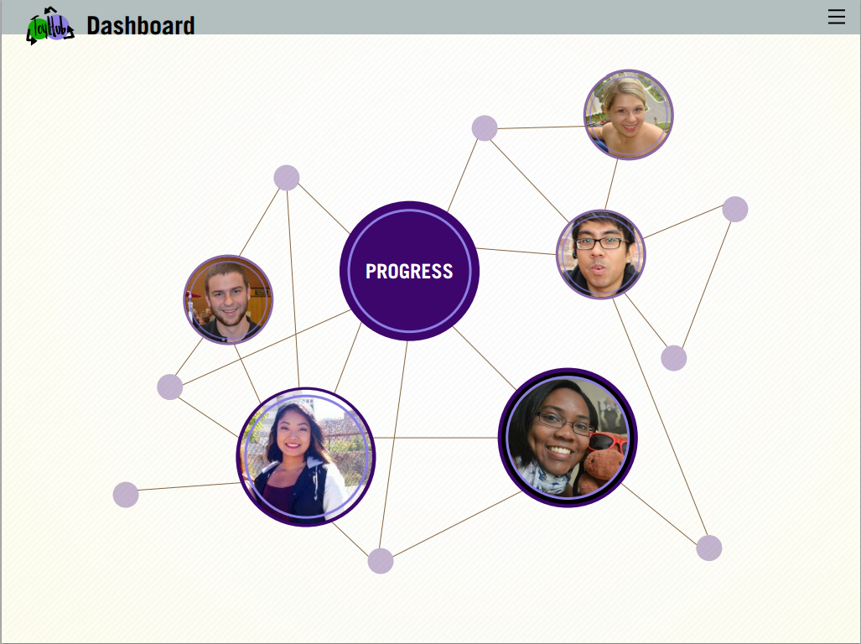
Design Team Dashboard
Organic
Connections

Slide 3
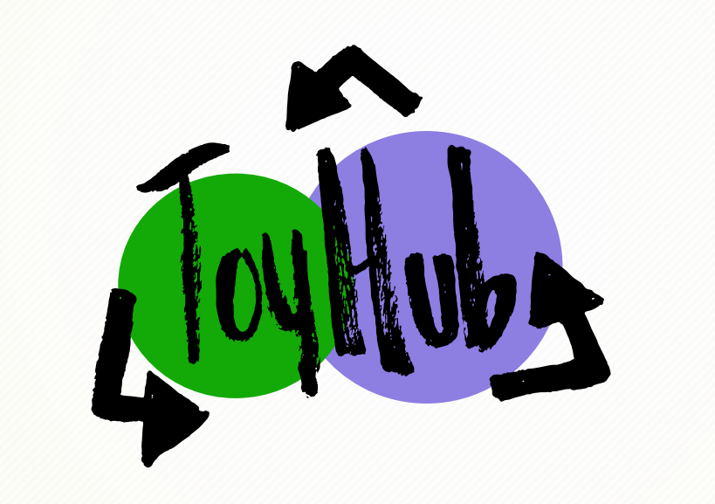
Feasibility
Can be implemented
D3 javascript library
Force Directed Graph
Json
Bootstrap
Can capture organic feel
Represent connections, vary size, play sound, and color.

Slide 4
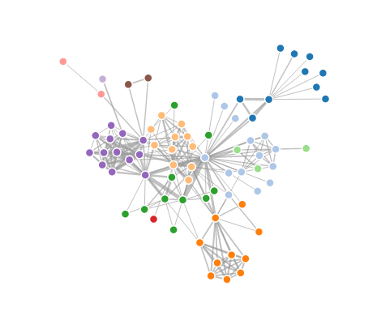
First Iteration

Slide 5
Feedback
Keep the color
Too cluttered
Add sound
Add movement

Slide 6
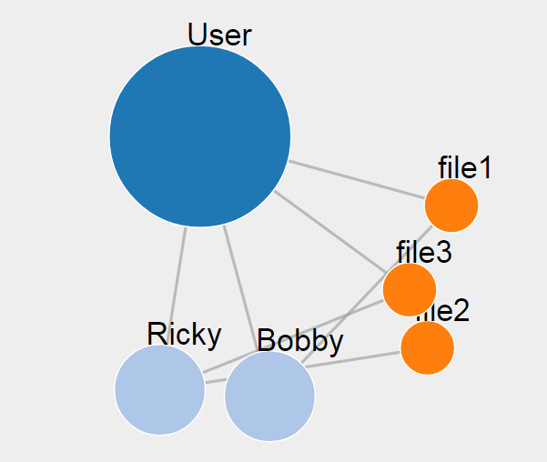
Final Iteration

